Slide 1


Monte Carlo Power Flow with Time-Coupled Profiles for Generating Training Datasets
Per-device perturbation using normal distribution & Aggregation to bus–phase nodes
D842_844ra @ 844.1: 0.25% P, 0.24% Q | M1 | Wye | 1φ
Training node features
$$Defining aggregate values per scenario \\ \text{P}\text{_}\text{load}\text{_}\text{total}\text{, }\text{Q}\text{_}\text{load}\text{_}\text{total}\text{, }\text{and} \text{P}\text{_}\text{PV}\text{_}\text{total}$$
Distribution to individual devices using predefined shares
844.a
p_load_kw, q_load_kvar
844.a
m1_p_kw, m1_q_kvar,
…
D844_846sb @ 844.2: 0.71% P, 0.57% Q | M1 | Wye | 1φ
$$24−hour load and irradiance profiles$$
$$(mL, mPV)$$
P_load(t) = P_load_total × mL(t), Q_load(t) = Q_load_total × mL(t), P_PV(t) = P_PV_total × mPV(t).
S844 @ 844: 22.89% P, 30.17% Q | M2 | Wye | 3φ
844.b
p_load_kw, q_load_kvar
844.b
m1_p_kw, m1_q_kvar,
…
D860_836sa @ 860.1.2 0.85% P, 0.72% Q | M1 | Delta | 1φ
…
Embedding vectors
Nodes and edges differ but there is only one shared message function for all edges, one shared update for all nodes.
We use node/edge features for what we can measure, and learnable embeddings for static structure not in the features.
Embeddings are updated during training via gradient descent.
…
…
Power flow solved using OpenDSS
Training labels
vmag
At each node
Second solve with zero PV output to obtain vmag_zero
(Only for the fifth model)
vmag_delta = vmag_with_pv − vmag_zero
At each node
Spatial and temporal error breakdown
Training for all models was performed on an NVIDIA L4 GPU

Slide 2
Model Comparison and Evolution
Model | Node Features | Edge Features | Additional information* | Best RMSE achieved** | Observation
1 | p_load_kw, q_load_kvar, p_pv_kw | R_full, X_full (self-impedance from impedance matrix, just for lines) | Bidirectional / with embedding vectors | 0.01653 | Worst performance in buses with capacitor bank injection and buses
2.1 | p_inj_kw, q_inj_kvar(q_load_kvar-q_cap_kvar) | Same as 1 | Bidirectional / with embedding vectors | 0.01503 | Worst performance in buses downstream of a transformer or a regulator
2.2 | Same as 2.1 | R_full, X_full (including winding resistance and leakage reactance for transformers and voltage regulators) | Bidirectional / with embedding vectors | 0.01462 | The final realized values (post-solve) are immensely different from the nominal values (pre-solve)
3.1 | m1_p_kw, m1_q_kvar, m2_p_kw, m2_q_kvar, m4_p_kw, m4_q_kvar, m5_p_kw, m5_q_kvar, q_cap_kvar, p_pv_kw | Same as 2.2 | number of training samples increased (worse performance with same number of training samples) | 0.01372 | Worst performance in buses close to the source bus
3.2 | Same as 3.1 | Same as 2.2 | Without node and edges embedding vector | 0.01589
3.3 | Same as 3.1, electrical_distance_ohm, p_sys_balance_kw, q_sys_balance_kvar | Same as 2.2 | Unidirectional / with embedding vectors | 0.00912
3.4 | Same as 3.2 | Same as 2.2 | Bidirectional / with embedding vectors | 0.00874
4.1 | Same as 3.2, phase_onehot_1, phase_onehot_2, phase_onehot_3 | Same as 2.2 | Bidirectional / Phase as one hot feature / with embedding vectors | 0.00851
4.2 | Same as 3.2 | Same as 2.2 | Bidirectional / Three different GNN trained each for one phase / with embedding vectors | 0.00801 | Training time substantially increased
5 | Same as 4.2, vmag_zero_pv_pu | Same as 2.2 | Bidirectional / Three different GNN trained each for one phase / with embedding vectors | 0.00836
* all models use h_dim=32, num_layers=4, node_emb_dim=8, edge_emb_dim=4 unless otherwise specified ** in vmag_pu / vmag_delta_pu

Slide 3
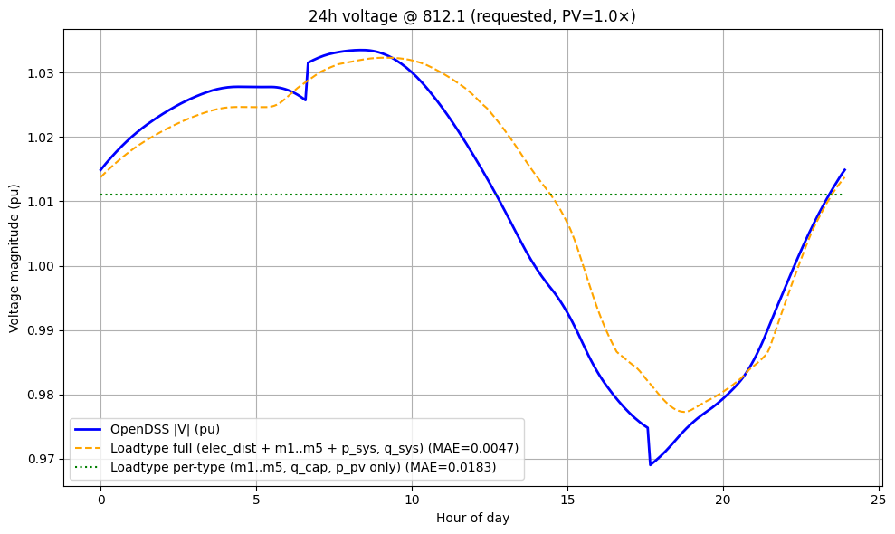
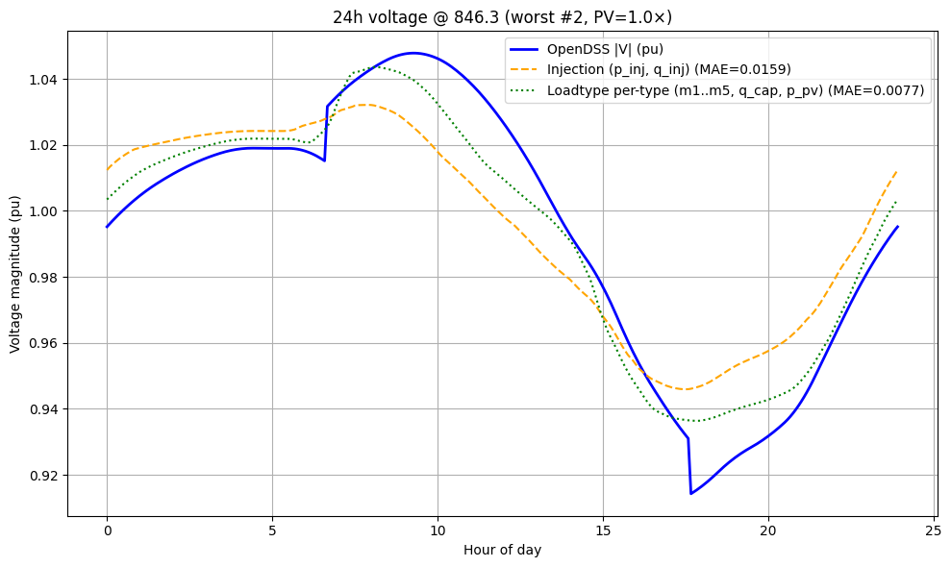
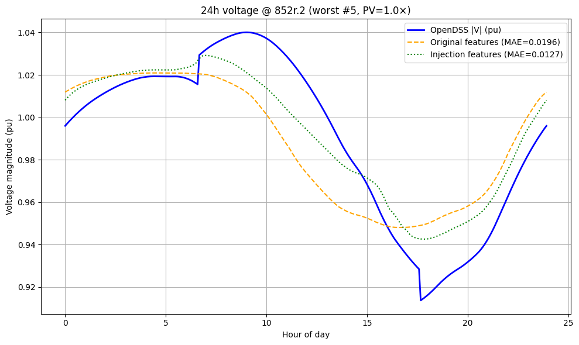
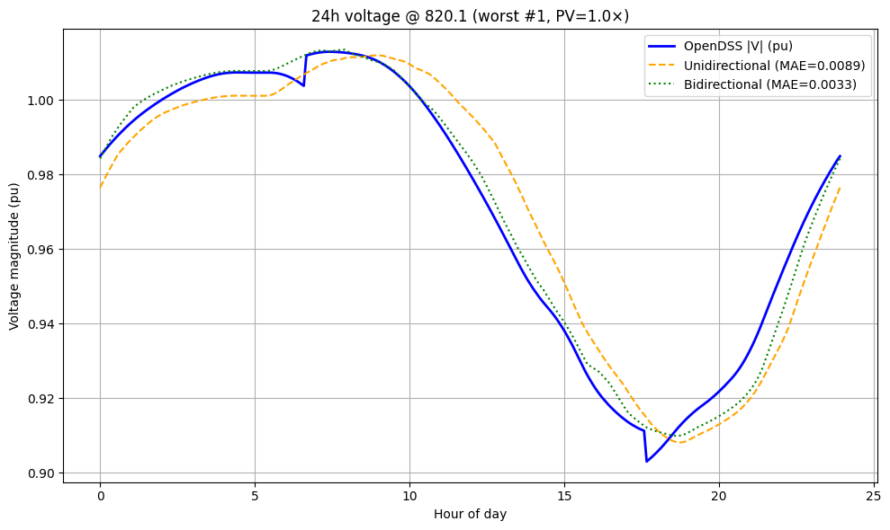
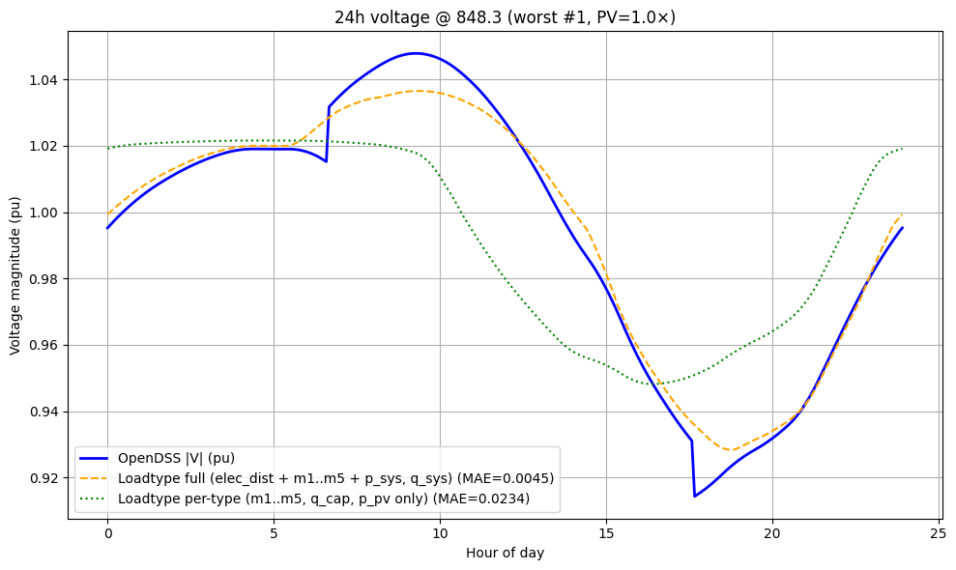
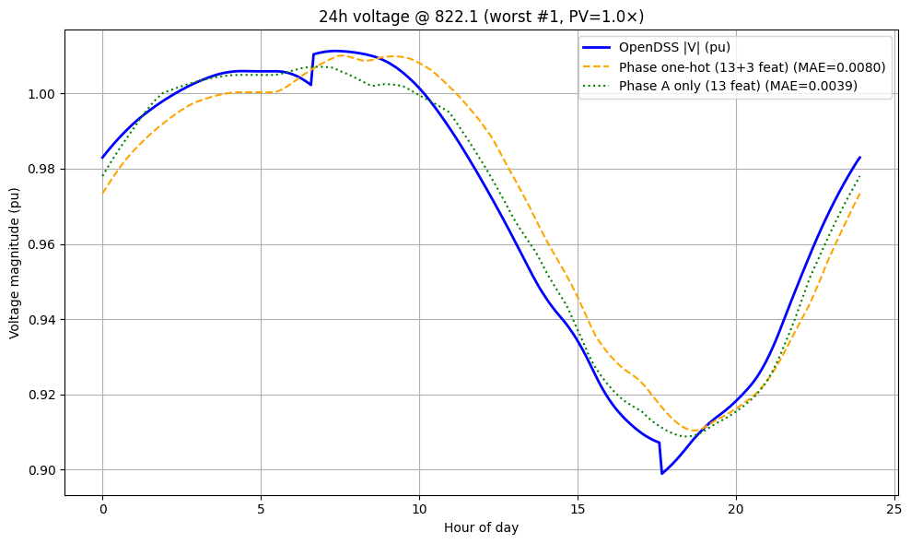
Results: OpenDSS vs GNN Predictions
24h voltage at node 812.1: OpenDSS vs 3.1 vs 3.3
24h voltage at node 852r.2: OpenDSS vs 1 vs 2.1
24h voltage at node 848.3: OpenDSS vs 3.1 vs 3.3
24h voltage at node 846.3: OpenDSS vs 2.2 vs 3.1
Same as 3.1, electrical_distance_ohm, p_sys_balance_kw, q_sys_balance_kvar
24h voltage at node 820.1: OpenDSS vs 3.3 vs 3.4
m1_p_kw, m1_q_kvar, m2_p_kw, m2_q_kvar, m4_p_kw, m4_q_kvar, m5_p_kw, m5_q_kvar, q_cap_kvar, p_pv_kw
24h voltage at node 822.1: OpenDSS vs 4.1 vs 4.2
m1_p_kw, m1_q_kvar, m2_p_kw, m2_q_kvar, m4_p_kw, m4_q_kvar, m5_p_kw, m5_q_kvar, q_cap_kvar, p_pv_kw
p_load_kw, q_load_kvar, p_pv_kw
Same as 3.1, electrical_distance_ohm, p_sys_balance_kw, q_sys_balance_kvar
m1_p_kw, m1_q_kvar, m2_p_kw, m2_q_kvar, m4_p_kw, m4_q_kvar, m5_p_kw, m5_q_kvar, q_cap_kvar, p_pv_kw
Three different GNN trained for each phase
p_inj_kw,
q_inj_kvar(q_load_kvar-q_cap_kvar)
Phase encoded as one-hot feature
Bidirectional edges
Unidirectional edges
p_inj_kw,
q_inj_kvar

